Slide 1
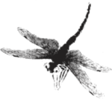
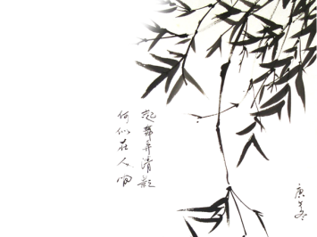
1. who are we? We are based in Guangdong，China, start from 2015,sell to North America(40.00%),Eastern Europe(30.00%),Japan(20%),Domestic Market(10.00%). There are total about 11-50 people in our office. 2. how can we guarantee quality? Always a pre-production sample before mass production; Always final Inspection before shipment; 3.what can you buy from us? Stuffed & Plush Toy Animal/Teddy Bears,Beach Towel,Baby Blankets,Cushion,Throw Pillow,Plush Keychains,Baby Backpack,slippers,etc. 4. why should you buy from us not from other suppliers? Dongguan Yourun Toys Co,.Ltd is specialized in all kinds of plush toys, electronic products, plush dolls, pet toys ,auto parts,home accessories,customized corporate mascot, Festival products, blankets, beach towels, backpacks, plush toys,etc. One-stop service,exclusive to your customization 5. what services can we provide? Accepted Delivery Terms: FOB,CFR,CIF,EXW,FAS,CIP,FCA,CPT,DDP,DDU； Accepted Payment Currency:USD,EUR,JPY,CAD,AUD,HKD,GBP,CNY; Accepted Payment Type: T/T,PayPal,Western Union,Cash; Language Spoken:English,Chinese
Why choose us?

Slide 2
创意品牌推广方案

